Slide 1
CHAPTER 4
APPLICATIONS OF DIFFERENTIATION

Slide 2
Objectives
Maximum and Minimum Values
The Mean Value Theorem
f’ and f’’ say about f
Optimization Problems:
Designing a poster.
Designing a can.
Distance between two ships.
Airplane landing path.
Sensitivity to medicine.
Quickest route.
In Construction:
etc.
Newton’s Method
Anti-derivatives

Slide 3
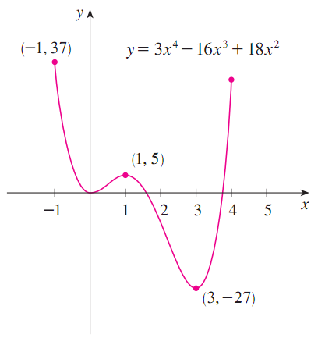
Maximum and Minimum Values (f)
(1) Absolute (global) maximum abs max
(2) Absolute (global) minimum abs min
(3) Local (relative) maximum (cực đại) loc max
(4) Local (relative) minimum (cực tiểu) loc min

Slide 4
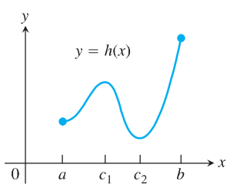
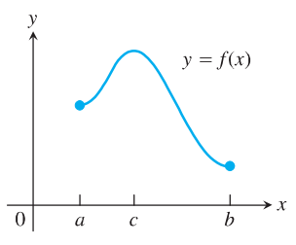
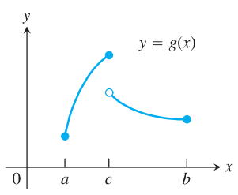
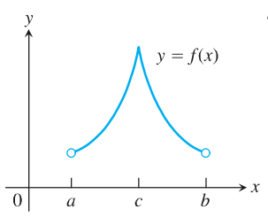
Examples
?
Abs max; abs min;
local max
Abs max; abs min;
local max; local min
Abs max;
local max;
Abs max; abs min;
local max;

Slide 5
How to find local min/max?
Always exist? NO
How to find?
Two ways:
1st derivative test
2nd derivatives test

Slide 6
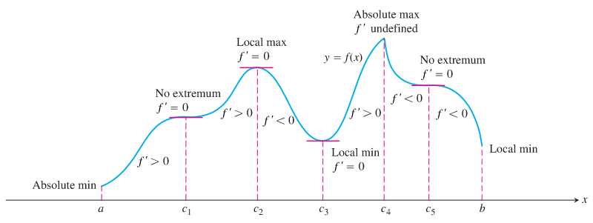
How Derivatives Affect the Shape of a Graph?
What Does f’ Say About f?
Increasing/Decreasing Test
If f’(x) > 0 on (a, b), then f is increasing on (a, b).
If f’(x) < 0 on (a, b), then f is decreasing on (a, b).
First Derivative Test for Local Extreme Values

Slide 7
First Derivative Test. Example.
Find the local minimum and maximum values of the function f(x) = x^{4/3} – 4x^{1/3}
Step 1
f(x) = x^{4/3} – 4x^{1/3} ➔ f’(x) = $\frac{4}{3}x^{\frac{1}{3}} − \frac{4}{3x^{\frac{2}{3}}}$ = $\frac{4(x−1)}{3x^{\frac{2}{3}}}$
Step 2
f’(x) = 0 ⇔ x = 1 and f’(0) is undefined //critical numbers
Step 3
Interval | -∞ 0 1 ∞
Sign of f’ | - undefined - 0 +
Behavior of f | decreasing decreasing increasing
f(1)
local min
Step 4
local min =f(1) at x=1

Slide 8
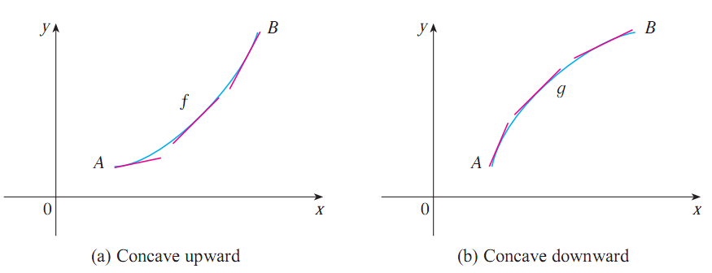
How Derivatives Affect the Shape of a Graph?
What Does f’’ Say About f?
Definition.
If the graph of f lies above all of its tangents on (a, b), then it is called concave upward on (a, b).
If the graph of f lies below all of its tangents on (a, b), it is called concave downward on (a, b).
f’ is increasing
f’ is decreasing

Slide 9
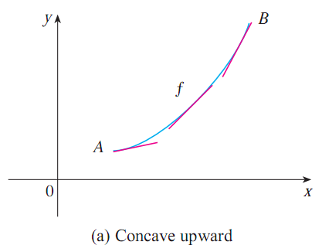
What Does f’’ Say About f? Concavity
The Second Derivative Test for Concavity
If f’’ > 0 on I, the graph of f over I is concave up.
If f’’ < 0 on I, the graph of f over I is concave down.
f’’ > 0 on I
f’ is increasing on I
graph of f over I is concave up.
f’ is increasing

Slide 10
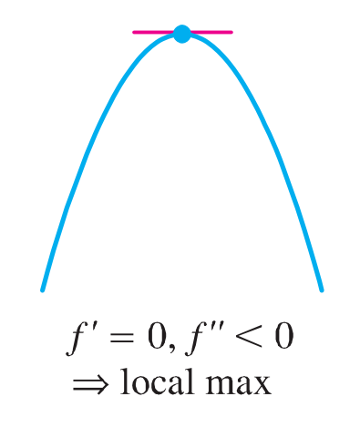
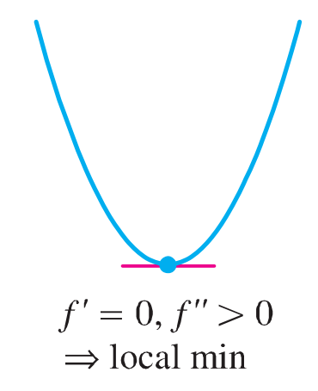
Second Derivative Test for Local extreme values
The Second Derivative Test.
Suppose f is continuous near c.
(a) If f’(c) = 0 and f’’(c) > 0, then f has a local minimum at c.
(b) If f’(c) = 0 and f’’(c) < 0, then has a local maximum at c.

Slide 11
Second Derivative Test. Example
Discuss the curve y = x⁴ - 4x³ with respect to concavity, points of inflection, and local maxima and minima.
f(x) = x⁴ - 4x³ ➔ f’(x) = 4x³ – 12x² ➔ f’’(x) = 12x² – 24x
f’(x) = 0 ⇔ 4x²(x – 3) = 0 ⇔ x = 0, x = 3.
f’(0) = 0, f’’(0) = 0: 2nd Derivative Test gives no information
f’(3) = 0, f’’(3) > 0: f(3) is loc min

Slide 12
f’’(x) = 0 ⇔ 12x(x – 2) = 0 ⇔ x = 0, x = 2.
Interval | -∞ 0 2 ∞
f’’(x) = 12x(x – 2) | + 0 - 0 +
Concavity of f | concave up concave down concave up
f’’ changes sign at x = 0, x = 2
➔ Inflection points: (0, f(0)), (2, f(2))

Slide 13
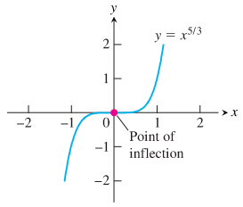
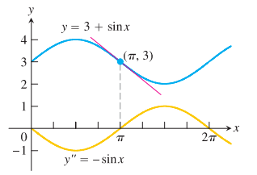
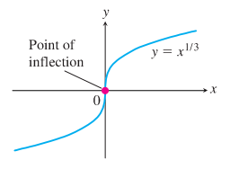
What Does f’’ Say About f? Inflection points.
Definition. A point where the graph of a function has a tangent line and where the concavity changes is a point of inflection (or inflection point).
Note: At a point of inflection (c, f(c)), either f’’(c) = 0 or f’’(c) fails to exist.
f(x) = x^{1/3}, f’’(0) and f’(0) fail to exist,
(0, 0) is an inflection point
f(x) = 3 + sinx, f’’(π) = 0,
(π, 3) is an inflection point
f(x) = x^{5/3}, f’’(0) fails to exist,
(0, 0) is an inflection point

Slide 14
Finding abs min/max
Always exist? No
How to find?

Slide 15
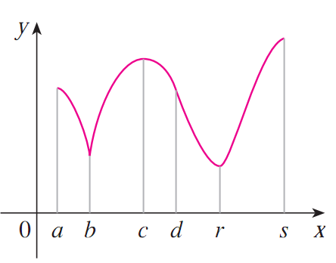
How to find abs max and min?
A few values need to be considered
◆

❖

⬥





& : endpoints
,  & : critical numbers

Slide 16
The Closed Interval Method
How to find the abs extreme values of a continuous function f on [a, b]?
Step 1. Evaluate f at all critical points and endpoints.
Step 2. Take the largest and smallest of these values
Example 1. Find the abs max and min values of f(x) = x² on [-2, 1].
critical number: f’(x) = 2x = 0 ⇔ x = 0 only
check the values:
Critical point value: f(0) = 0 (abs min)
Endpoint values: f(-2) = 4 (abs max), f(1) = 1

Slide 17
Example 2. Find the absolute maximum and minimum values of g(t) = 32t – t⁴ on [-1, 1].
Critical number: g’(t) = 32 – 4t³ = 0 ⇔ t = 2 > 1, not in [-1, 1]
The function's abs max and min values therefore occur at the endpoints:
g(-1) = -33 (abs min)
g(1) = 31 (abs max)

Slide 18
Rolle’s Theorem

Slide 19
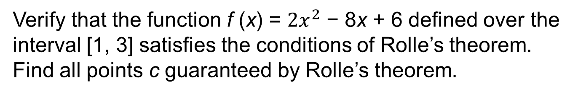
Using Rolle’s Theorem
For each of the following functions, verify that the function satisfies the criteria stated in Rolle’s theorem and find
all values c in the given interval where f ′(c) = 0.
Do yourself
Verify that the function f (x) = $2x^{2}$ − 8x + 6 defined over the interval [1, 3] satisfies the conditions of Rolle’s theorem. Find all points c guaranteed by Rolle’s theorem.

Slide 20
Prove that the equation $x^{3}+x−1=0$has exactly one real root.
So the Intermediate Value Theorem states that there is a number between 0 and 1 such that f(c)=0 . Thus the given equation has a root.

Slide 21
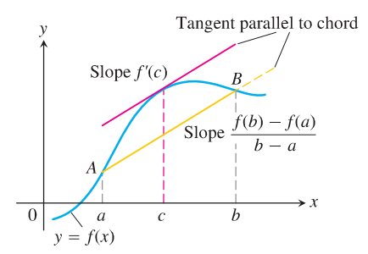

The mean value theorem (MVT)
(MVT). Suppose:
f is continuous on [a, b]
f is differentiable on (a, b).
Then ∃c  (a, b) such that: $\frac{f\left(b\right)−f(a)}{b−a}=f^{′}\left(c\right)$
1. f’(x) = 0 for each x in (a, b) ⇔ f(x) = ???
2. f’(x) = g’(x) for each x in (a, b)
⇔ f(x) = g(x) on (a, b) ???

Slide 22
There exists a number such that
The largest possible value for f(2) is 7.

Slide 23
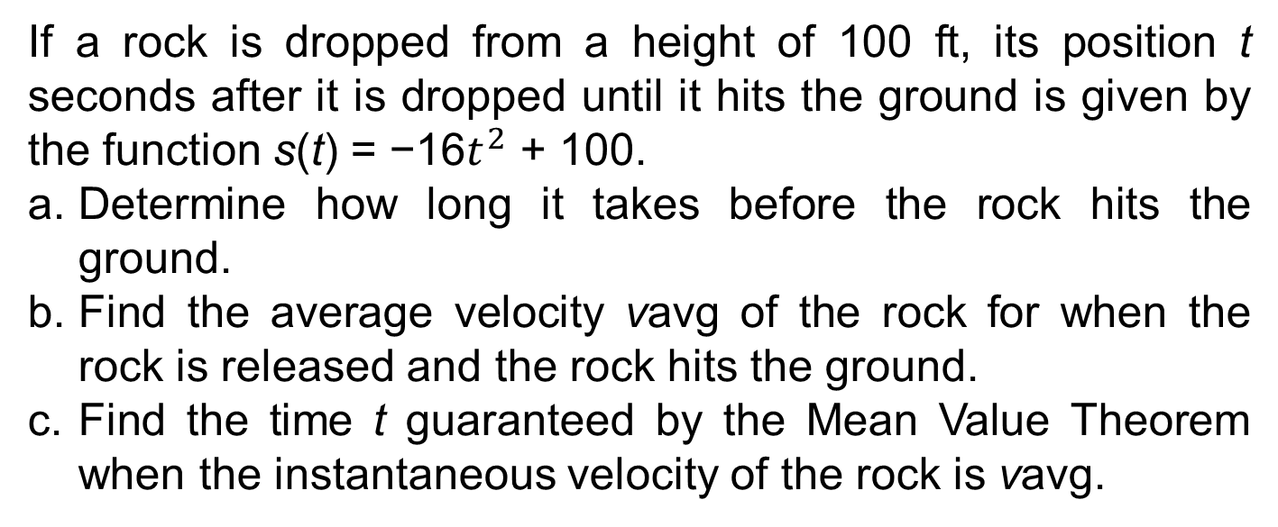
Mean Value Theorem and Velocity
If a rock is dropped from a height of 100 ft, its position t seconds after it is dropped until it hits the ground is given by the function s(t) = −16$t^{2}$ + 100.
Determine how long it takes before the rock hits the ground.
Find the average velocity vavg of the rock for when the rock is released and the rock hits the ground.
Find the time t guaranteed by the Mean Value Theorem when the instantaneous velocity of the rock is vavg.

Slide 24
Optimization Problems
Applications in many areas of life:
A businessperson wants to minimize costs and maximize profits.
A traveler wants to minimize transportation time.
Problems as maximizing areas, volumes, and profits and minimizing distances, times, and costs.
Steps in Solving Optimization Problems
Read the problem.
Draw a Diagram.
Introduce variables.
Write an equation for the unknown quantity.
Express the unknown as a function of a single variable.
Find the abs max or abs min values of the function.

Slide 25
Do your self
Find the point on the line y = 2x + 3 that is closest to the origin.
Find two positive numbers whose product is 100 and whose sum is a minimum.
A box with a square base and open top must have a volume of 32,000 cm . Find the dimensions of the box that minimize the amount of material used.

Slide 26
Newton’s Method (Newton - Raphson method).
No formula to find the root of an equation f(x) = 0 (e.g., cosx – x = 0).
➔ approximate it.
Newton’s Method: A technique to approximate.
Well suited for computers or calculators.
HOW TO APPROXIMATE?
x₁ ⇒ x₂ ⇒ x₃ ⇒ x₄ ⇒ …
⇒ x_{n} ⇒ x_{n+1} root of an equation

Slide 27
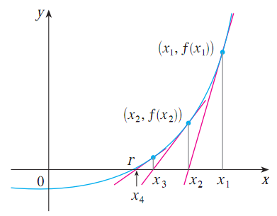
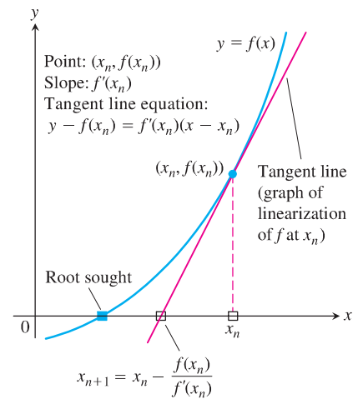
Newton’s Method
Need to approximate the root of the equation f(x) = 0.
Start by choosing an x₁ near root
❖
⬥



◆


Fourth Third Second First
APPROXIMATIONS
x₄ ≈ r
x_{n} → r

Slide 28


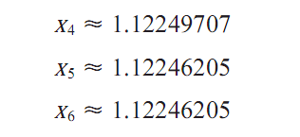



Newton’s Method. Example
Use Newton’s method to find $\sqrt[6]{2}$ correct to eight decimal places.
➔ Approximate the root of the equation x⁶ = 2.
f(x) = x⁶ – 2 = 0, f’(x) = 6x⁵
Choose x₁ = 1. (just guess, 1 near r)
Use the formula
x₁ ⇒ x₂
x₂ = 1 - $\frac{f(1)}{f′(1)}$ = 1 - $\frac{−1}{6}$ = $\frac{7}{6}$ ≈ 1.16666667
x₂ ⇒ x₃
x₃ ≈ 1.12644368
x₅ and x₆ agree eight decimal places
x_{n} → r

Slide 29
Anti-derivatives
Definition. A function F is called an anti-derivative of f on an interval I if
F’(x) = f(x)
for all x in I.
Theorem. If F is an anti-derivative of f on an interval I, then the most general anti-derivative of f on I is
F(x) + C
where C is an arbitrary constant.
Examples.
F(x) | f(x) | Relationship F’(x) = f(x)
F(x) = x² | f(x) = 2x | (x²)’ = 2x
F(x) = sinx | f(x) = cosx | (sinx)’ = cosx
F(x) = x² + 2018 | f(x) = 2x | (x² + 2018)’ = 2x

Slide 30
Summary
Maximum and Minimum Values
The Mean Value Theorem
f’ and f’’ say about f
Optimization Problems
Newton’s Method
Anti-derivatives

